Slide 1
UI and UX comparison presentation

Slide 2
Agenda
Comparison between spotify and youtube music

Slide 3


Slide 4

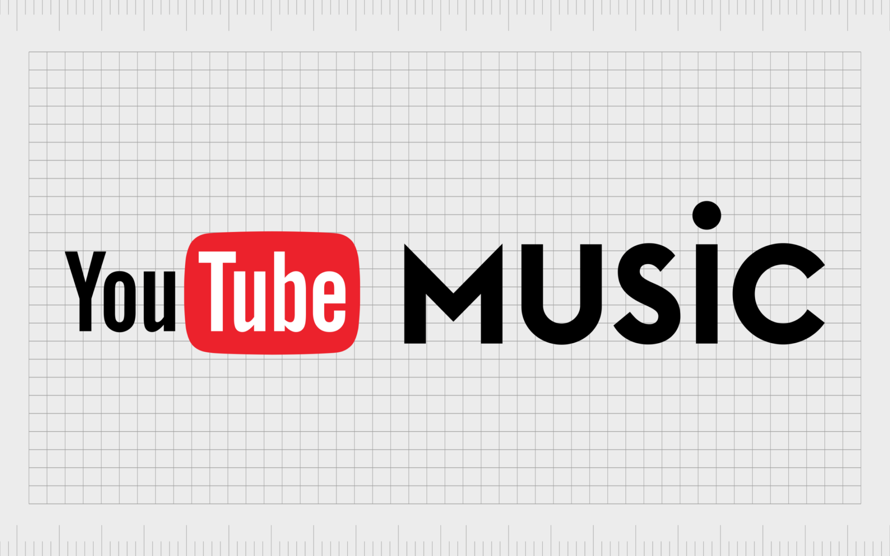
Comparison Between Spotify and youtube music:

Slide 5


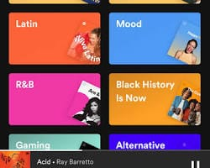

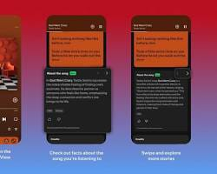
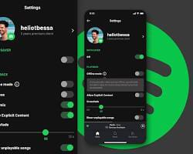
Spotify:
Login screen:
Home screen:
Search screen:
Profile screen:
Product/playing screen:
Setting screen:

Slide 6
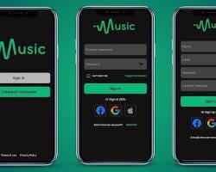
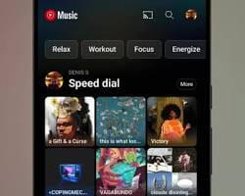
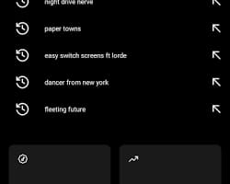
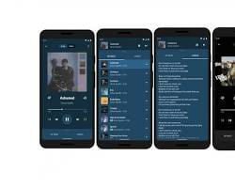

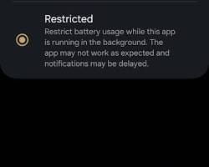
login screen: home screen: search screen:
Youtube music:
Play screen:
Profile screen:
Setting screen:

Slide 7
Comparison between Spotify and Youtube music:
Logo and branding: Neon green colour icon with three black sound waves. Color scheme: * Deep slate grey to charcoal background. * high contrast hierarchy that keeps focus on albums. Typography: * cústomized circular sans serif font. Icons: * Custom outlines icons. * highly intuitive. Buttons: * pill shaped buttons. * high contrast neon targets. | Uses red play button nclosd in red circular ring. True OLED pure black with strong visual contrast. Uses google roboto / product sans extremely clean. Standard google material design icons. Material design circular and capsule buttons.

Slide 8
Spotify: Youtube music:
Advantages: * best in class music discovery. * superior social features. * easy playback. * all in one audio editor. Disadvantages: * catalogue limits. * free tier limits. | Advantages: * unrivaled content library. * seamless music video. * incredible value. Disadvantages: * less polished ecosystem. * podcasts feel cluttered.

Slide 9
thank you

